Slide 1
Sustainable Hub
APP TO CREATE ECO-FRIENDLY BONDS
EGALITARIAN 2024

Slide 2
Gap between interest and action
Customer
Decentralized information about sustainable initiatives
Exacerbated consumption
Low visibility
Sustainable
Initiatives
NGOs, Sustainable Projects, Events

Slide 3
interest in sustainability 2019 - 2020
search for sustainable products
2016 - 2020
+ 40,4%
+ 71%
PUCRS | Economist Intelligence Unit (EIU)

Slide 4
The information is not centralized;
How it "works" now?
People have to search on Google where to disposal things, and sometimes they don't even find the information;
People are interested in the issue but don't act on it because of the complexity

Slide 5
How to transform people's concerns about sustainability into actions?

Slide 6
Ecosystem of sustainable solutions that aims to encourage conscious actions by the population through convenience and pleasant experience

Slide 7
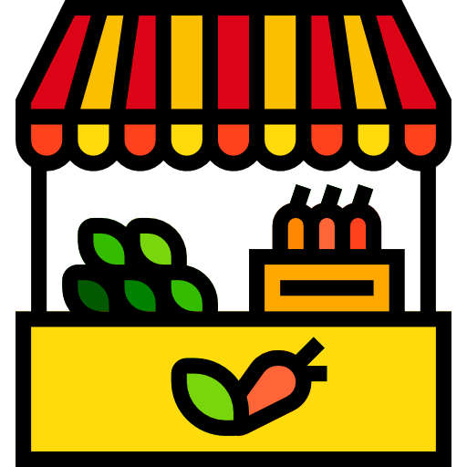


Sustainable Hub
An App that reunites all of the main sustainable initiatives to make a connection between wanting to be more sustainable and being more sustainable, working as:
Marketplace
Information
Communities

Slide 8
Marketplace

Slide 9


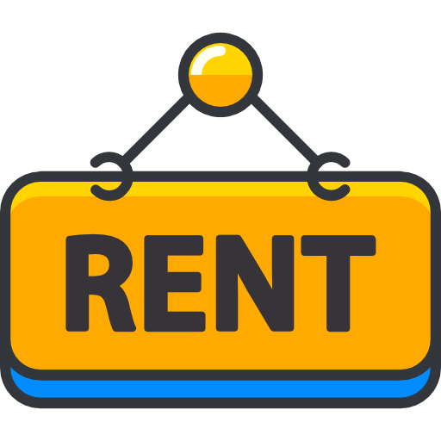
Marketplace
Area to connect consumers and providers. It will be divided into three main parts:
1
2
3
Purchase/Sale with sustainable stores
Donations: materials, volunteering, money
Rent/borrowing things that are not used often

Slide 10
Information and Awareness

Slide 11
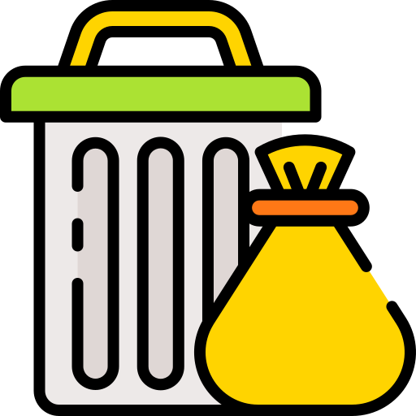


Information and awareness
Area of ​​awareness about the proper disposal of waste and the consequences of the lack of this practice
4
Having information about the disposal of hazardous waste
Providing options for reuse/recycle of organic materials
5
6
Informing which area is the closest that accept the materials

Slide 12
Communities

Slide 13

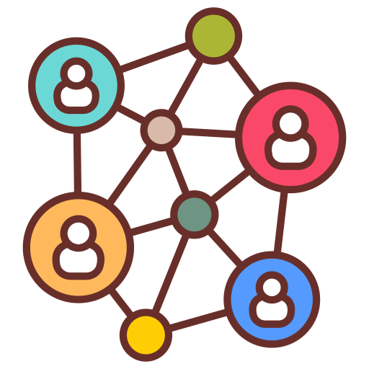

Communities
Area to connect people with interest in sustainability:
7
8
9
Share ideas, projects and initiatives
Have a way to communicate with other people
Reach more people and build a bigger community

Slide 14

Tokens
You can get tokens by buying, selling and donating things
With this tokens you can "buy" sustainable initiatives
Related to gamification, where users will be able to use the tokens and other people in the community will be able to see that person's impact on society

Slide 15





Slide 17
Work PSP2 last semester (2/2023)
Must Have: Donations module vision document (2); Information module vision document (4 and 5); Idea dissemination module vision document (7).
DONE
Should Have: Prototype of the donation module screens (2); Prototype of information module screens (4 and 5); Prototype of the idea dissemination module screens (7).
Nice to Have: Rent/borrowing Material module vision document (3); Prototype of the material module screens (3).

Slide 18
Work PSP5 last semester (2/2023)
Must Have: User journey of the donation module (2); Journey of users of the information module (4 and 5); Journey of users of the idea dissemination module (7).
DONE
Nice to Have: Journey of users of the Rent/borrowing Material module (3).

Slide 19
Sustainable Hub App - Scopes (1/2024)
PSP2 : Requirements gathering + product backlog items creation + design of the non-functional prototype
Energy engineering : Impact analysis framework (e.g. how to measure the reduction in the carbon footprint that the app will generate? In which app modules can this be presented?
Smart solutions: Analysis and strategic planning for adherence to the app

